Slide 1
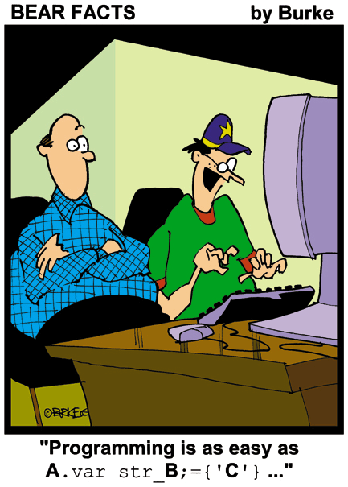

Slide 2
Objects – State
There are only two things we can do to an object
  Inspect it’s state
  Alter it’s state
This is a profound statement!
If you think of ANY electronic device that you have interacted with you will find that you either alter it’s state or inspect it!
In fact, it is true of any object you interact with.

Slide 3
Recording state
To be able to inspect and alter the state of an object we need to be able to record the state!
For example, how can we inspect the current state of a phone “contacts list” to see if it contains a particular name, if we have not recorded the list of names?
How can we delete a text message if we have not recorded a list of the messages previously received?

Slide 4
Variables and State
Programming languages use variables to record state.
They are called variables because they can be altered (i.e. the value can vary or it is “variable”).
For example, mortgage and loan interest rates are often described as “variable.” That just means they can change but they are still interest rates.
At any instant in time a variable can record the CURRENT state of something (i.e. ONE thing).
Inspection will tell you what that state is.
Alteration will change the state to a new state.

Slide 5
Variables and State
For example, a contacts list might have a collection of 150 names in it at the moment (i.e. the current state).
After inserting a new name the list will have 151 (i.e. the new state).
To record the state of a contacts list requires at least
  a variable to record the collection of names, and
  a variable to record the number of names (or the list size).
Insertion includes the name in the collection and increases the value of the list size so that the current state of the contacts list is correctly recorded.
Deletion removes the name from the collection and decreases the value of the list size so that the current state of the contacts list continues to be correctly recorded.

Slide 6
Variables and State
As another example, consider the signal level in a phone.
The phone needs to store the current signal level so that it can check (inspect) if it is possible to make a call or send a text.
Signal level can change (i.e. it is variable).
Each time it changes the variable recording the signal level is altered to reflect the current state so that intelligent decisions can be made about sending texts or making calls.
A similar scenario applies to the battery.

Slide 7
Variables and State
Some variables are used for recording alphabetic data like names, the contents of a text message, an mp3 track title, or someone’s address.
This type of alphabetic-style data is usually referred to as text or character data.
In programming languages it tends to be referred to as String data (i.e. a string of characters).

Slide 8
Variables and State
Other variables are used for recording numeric data like the amount of phone credit left, the phone signal and battery level, or how long the phone has been switched on.
This type of data is referred to as numeric data.
In programming languages it tends to be referred to as integer (i.e. whole numbers) or floating point (i.e. numbers with factions)

Slide 9
Variables and State
A third type of data that is useful in computing in general and programming in particular, is called boolean.
Unlike the other data types which can have an infinite number of values boolean data has only two possible values - true or false.
For example, whether a phone keypad is locked or not can be recorded very easily using a boolean value.
true might mean the keypad is locked and false might mean it is not.

Slide 10
Variables and State
It also necessary to be able to refer to objects that are created.
The variables used to refer to object instances are called object references.
Each time a BlueJ object is created it is given a name (i.e. either the default one suggested by BlueJ or a preferred one that you have chosen) and it has a type (i.e. the class of which it is an instance).

Slide 11
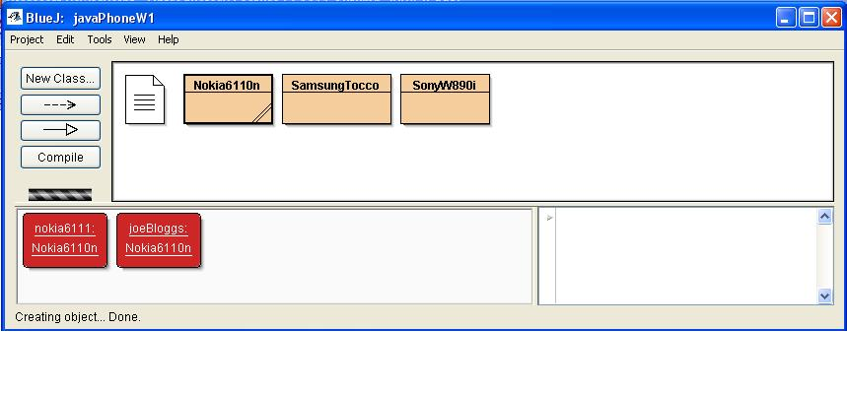
The name of the object reference variable is nokia6111 (suggested by BlueJ) and it refers to an object instance of the Nokia6110n class
The name of the object reference variable is joeBloggs (my preference) and it refers to an object instance of the Nokia6110n class

Slide 12
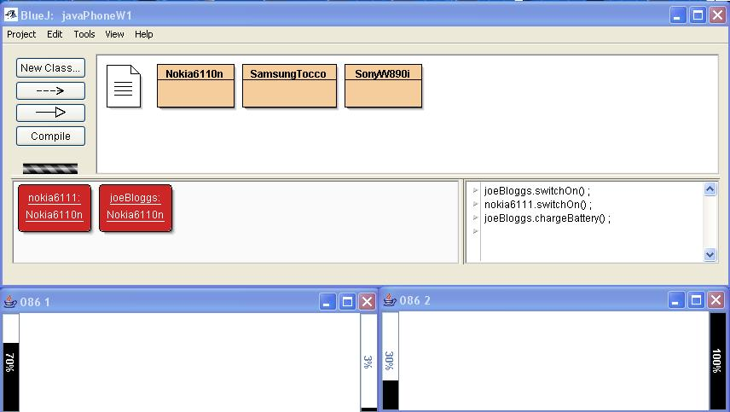
Use the object reference variable name to identify the object to be manipulated

Slide 13
Variables and State
Deciding which states need to be recorded is one of the most important parts of software development (regardless of the language you are using).
What states do you think would be important in a mobile phone?
Whatever you decide, for recording purposes you will need a variable for each state.

Slide 14
Variables and State
A variable has two important properties
  Type
  Name
The type specifies the type of data the variable will store (i.e. string, integer, float, boolean or a reference to an object).
The name is required to allow us to refer to it.
For each variable we want to use to record the state of something we will have to provide a name and data type for it.

Slide 15
Variables and State
provider is the variable name we want to use to refer to a Provider object
public class Nokia6110n extends AbstractMobile
{
private String number;
private Provider provider;
private boolean switchedOn ;
private long timeSwitchedOn;
private long batteryLevel ;
private int signalLevel;
public Nokia6110n(String numb)
{
number = numb;
switchedOn = false ;
batteryLevel = USABLE_BATTERY_LEVEL ;
signalLevel = checkSignal() ;
provider = connect();
}
public void switchOn()
{
if(batteryLevel < USABLE_BATTERY_LEVEL) {
switchedOn is a variable name that can store a true or false value
int and long are abbreviations for the data types integer and long integer

Slide 16
Variables and state
THE INITIAL STATE RANKS AS ONE OF THE MOST IMPORTANT STATES TO BE RECORDED.
For example, when you get a new phone you typically
  Charge the battery
  Set the date and time
  Start entering the names and numbers of your closest friends and contacts
  Set your preferred ring tone, etc.
You are setting or recording the initial state you want the phone to have, so that it will work the way YOU want it to – not the way someone in Nokia, Samsung or Sony wants it to.

Slide 17
Variables and State
The initial state is absolutely crucial because if we start with an incorrect initial state all of our actions, even though they themselves are correct, will produce incorrect outcomes or results.
Observe that when you fill your car with petrol the pump is set to zero BEFORE you start filling. Why?
When you start a game the score is usually set to “no score.” Why?
Because, of course, an important part of “starting” a game involves laying things out properly (e.g. pieces on a board, players on a pitch, objects on a screen) so that the rules and moves can be applied correctly and fairly.

Slide 18
Variables and State
In computing the process of recording the initial state is usually referred to as initialisation or configuration or set-up.
In Java, and other object-oriented programming languages, it is called CONSTRUCTION because it happens as something new is being created.
Consequently, every Java class has what is called a constructor.
The constructor is easily identifiable because it has EXACTLY the same name as the class.

Slide 19
Variables and State - Constructor
]^{Important States}
public class Nokia6110n extends AbstractMobile
{
private String number;
private Provider provider;
private boolean switchedOn ;
private long timeSwitchedOn;
private long batteryLevel ;
private int signalLevel;
public Nokia6110n(String numb)
{
number = numb;
switchedOn = false ;
batteryLevel = USABLE_BATTERY_LEVEL ;
signalLevel = checkSignal() ;
provider = connect();
}
public void switchOn()
{
if(batteryLevel < USABLE_BATTERY_LEVEL) {
]^{Constructor}

Slide 20
Variables and State - Constructor
Note the layout of the Java code
  the collection of states that we believe are important for objects of this class are listed first. There is a variable name and a type for each one.
  this is followed by the constructor.
Every object (i.e. instance of the class) that is created will have a set of these variables to record it’s state.
For this reason they are referred to as the instance variables.

Slide 21
Variables and State - Constructor
]^{Important States}
public class Nokia6110n extends AbstractMobile
{
private String number;
private Provider provider;
private boolean switchedOn ;
private long timeSwitchedOn;
private long batteryLevel ;
private int signalLevel;
public Nokia6110n(String numb)
{
number = numb;
switchedOn = false ;
batteryLevel = USABLE_BATTERY_LEVEL ;
signalLevel = checkSignal() ;
provider = connect();
}
public void switchOn()
{
if(batteryLevel < USABLE_BATTERY_LEVEL) {
Instance variables
]^{Constructor}

Slide 22
Variables and State - Constructor
Every time you create an instance (i.e. object) of the class Nokia6110n the Java system will execute the constructor to set the initial state of the object.
Only AFTER the constructor has been executed will the object be available for other manipulations.

Slide 23
Variables and State - Constructor
If you do not provide a constructor Java will use default values which may not be suitable.
For example, in the absence of a constructor for our Nokia6110n class Java the phone would have no number, a battery and signal level of zero and a non-existent provider.
YOU SHOULD ALWAYS PROVIDE A CONSTRUCTOR FOR A CLASS.

Slide 24
Classes and Objects
NB
Class describes behaviour.
Object is an instance of the class that allows behaviour to be realised.
Object state records the current state of the realisation.
Behaviour provides the tools for inspecting and altering the state.

Slide 25
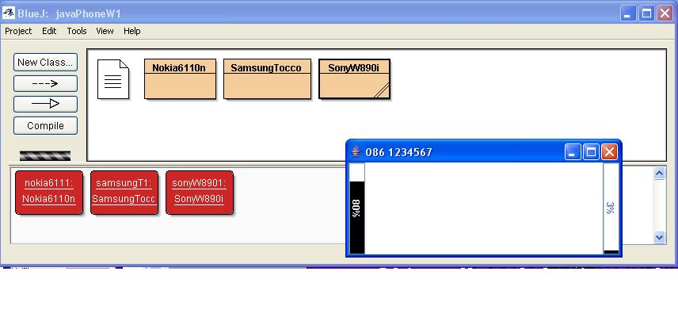
Visual representation of state

Slide 26
Inspections
Most programming languages allow the state to be inspected for well-known operations such as
  Less than (<)
  Less than or equal (<=)
  Greater than (>)
  Greater than or equal to (>=)
and well-known but with a slightly different way of writing them
  Equality or exactly equal ( = = )
  NOT Equal (!=)
Technically speaking these are what programmers call relational operators because their purpose is to inspect the current state and establish if the relationship specified actually exists.

Slide 27
Inspections
To inspect the current state you use a relational operator with one or more state instance variables.
For example
  batteryLevel < USABLE_BATTERY_LEVEL
  batteryLevel < MAXIMUM_BATTERY_LEVEL
  signalLevel < USABLE_SIGNAL_LEVEL
If the relationship exists the result of the inspection will be true.
If the relationship does not exist the result of the inspection will be false.

Slide 28
Inspections
NOTE
  For integers, when we ask is X < Y it is interpreted as “is the value stored in X is less than the value stored in Y”
  For strings, when we ask is X < Y it is interpreted as “does the string stored in X alphabetically precede the string stored in Y”
  Comparing floating point values for equality may be problematic

Slide 29
Inspections
Most programming languages use the if statement to specify single, ‘do it once’ inspections
For example
  if(signalLevel < MIN_LEVEL)
  if(switchedOn)

Slide 30
Inspections
Most programming languages provide a while statement for specifying repeated inspections
For example
  while(batteryLevel < MIN_LEVEL)
  while(key != “enter”)

Slide 31
Question
What will the following piece of code do?
String key ;
key = waitForKeyPress() ;
while(key != “Escape”) {
  key = waitForKeyPress() ;
  }

